Slide 1
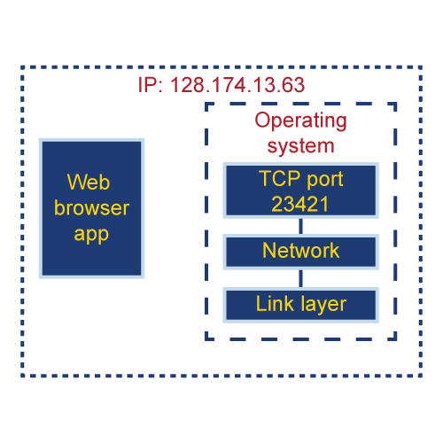
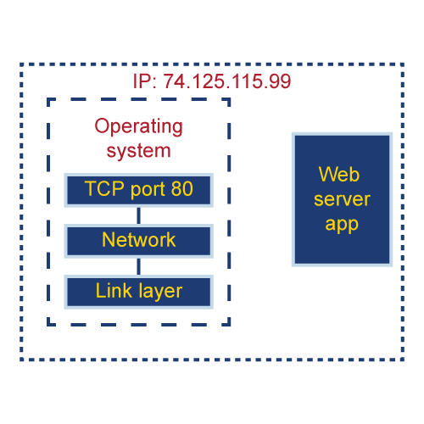
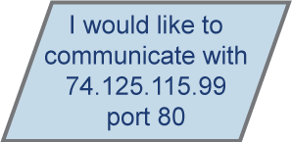
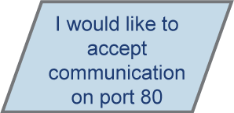
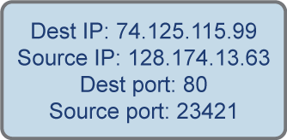
Starting TCP Connection – A High Level View
Server set-up
The server application opens a TCP socket for listening on port 80.
Socket
The operating system returns a socket that can be used for listening.
sendto(socket, …)
The application listens for new connections.
recvfrom(socket, …)
listen(socket, …)
Connection set-up
listen(socket, …)
shutdown(socket, …)
The client application opens a TCP socket to a destination IP address and destination port.
…
TCP in the client operating system sends a packet to the destination IP address and port.
The packet arrives at the server.
Socket
Internet

Slide 2
Starting TCP Connection – High Level View
Server set-up
Connection set-up (continued)
The server application opens a TCP socket for listening on port 80.
The networking protocol stack in the server operating system receives this packet and, since an application is listening on this destination port, TCP sends a response back to the client.
The operating system returns a socket that can be used for listening.
The application listens for new connections.
Connection set-up
The client application opens a TCP socket to a destination IP address and destination port.
TCP in the client operating system sends a packet to the destination IP address and port.
The packet arrives at the server.
Socket
Internet

Slide 3
Starting TCP Connection – High Level View
Server set-up
Connection set-up (continued)
The server application opens a TCP socket for listening on port 80.
The networking protocol stack in the server operating system receives this packet and, since an application is listening on this destination port, TCP sends a response back to the client.
The operating system returns a socket that can be used for listening.
The application listens for new connections.
When the response arrives at the client, the operating system
Connection set-up
Generates a socket that is given to the client application.
The client application opens a TCP socket to a destination IP address and destination port.
Sends another response back to the server.
TCP in the client operating system sends a packet to the destination IP address and port.
When the response from the client is received by the server, a socket is generated and given to the listening application.
The packet arrives at the server.
Socket
Socket
Socket
Internet

Slide 4
Starting TCP Connection – High Level View
Connection set-up
…
The client has a socket for communicating with the server.
The server has a socket for communicating with the client.
Socket
Socket
Socket
Internet

Slide 5
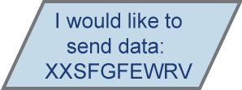
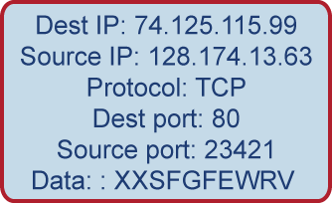

Starting TCP Connection – High Level View
Connection set-up
Communicating over TCP
…
Application calls an operating system function to send data:
The client has a socket for communicating with the server.
send(socket, data, ….)
The server has a socket for communicating with the client.
The networking stack makes a packet;
And sends the packet to the destination.
When the packet arrives, the data can be retrieved using an operating system function:
recv(socket, buffer)
And so on (with these sockets, data can be sent in either direction).
Socket
Socket
Socket
Internet

Slide 6
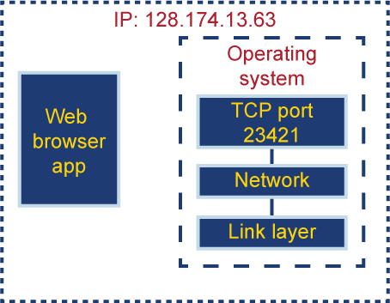
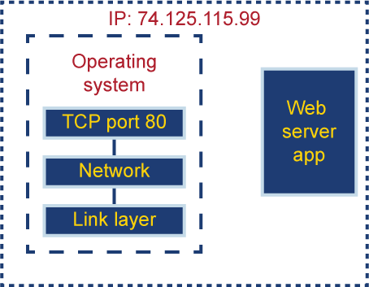
TCP Connection: Questions
How many packets are exchanged before the server
can send data to the client?
Does the client or server send the first packet?
The client. In all protocols, the client starts the transaction
Three. The client sends the first packet. The server responds.
The client sends a response to the server response. When this
response from the client is received, the server application gets
a socket. This socket can be used to send and receive data.
What information does the client provide to the
OS when starting a connection?
How many sockets does the server use?
The destination address
One socket for listening and one socket for each connection
The destination port
If a web server received three connections, then four sockets
have been used.
Socket
Socket
Socket
Internet

Slide 7
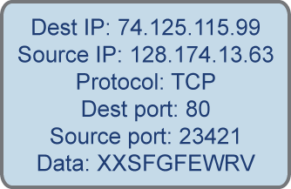
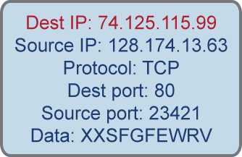
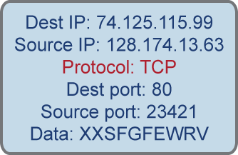
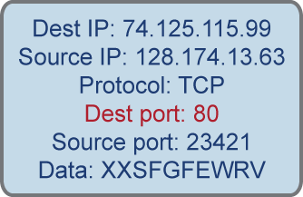
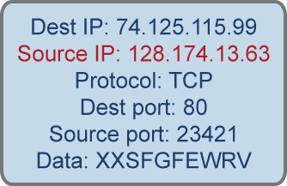
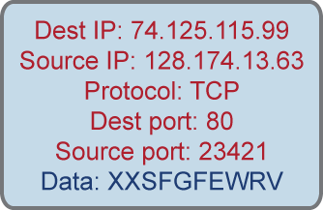
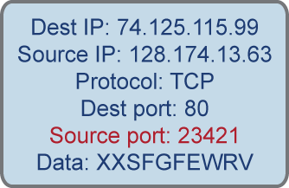
The 5-Tuple
When the packet arrives at the server, how does the networking stack know which application gets the packet?
The protocol (TCP)?
No. There might be many TCP connections to the server.
The destination IP?
No. All packets that arrive at the server will have this destination IP address.
The destination port?
No. All packets to the web server will have this destination port?
The source IP?
No. The web browser might be downloading multiple web objects at the same time.
The source port?
No. Other browsers on other machines might use the same port.
All 5. The 5-tuple: destination IP, destination port, source IP, source port, protocol
Socket
Socket
Socket
Internet

Slide 8
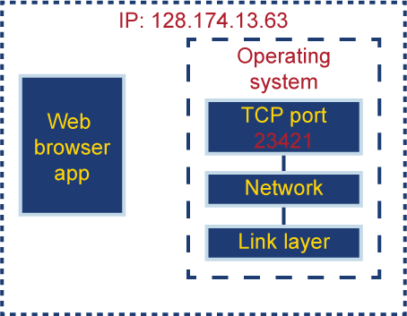
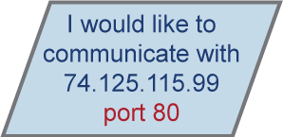
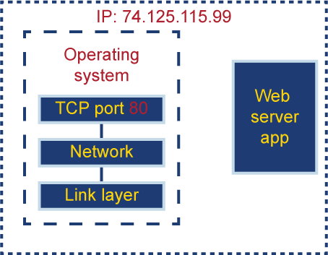
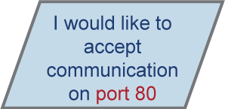
The 5-Tuple
The server is listening on port 80
That is:
The client uses port 23421
The server controls which port it will use.
How are these ports assigned?
The client cannot control which port it will use.
Server
When the client application requests to make
a connection to the server, it specifies the destination IP and the destination port.
When the web server application makes a socket, it tells the OS
the port it will use.
If this port is already in use, the request to get
a socket for the port will fail.
The server port must be known to the client.
Client
Many ports are used for specific applications:
When the client connects to the server, the OS will assign
an available port to the connection.
Web servers: 80, SSH: 22, Email: 25
https://en.wikipedia.org/wiki/List_of_TCP_and_UDP_port_numbers
Socket
Socket
Socket
Internet

Slide 9
The 5-Tuple
When the packet arrives at the server, how does the networking stack know which socket gets the packet?
The protocol (TCP)?
No. There might be many TCP connections to the server.
The destination IP?
No. All packets that arrive at the server will have this destination IP address.
The destination port?
No. All packets to the web server will have this destination port.
The source IP?
No. The web browser might be downloading multiple web objects at the same time.
The source port?
No. Other browsers on other machines might use the same port.
All 5. The 5-tuple: destination IP, destination port, source IP, source port, protocol.
Socket
Socket
Socket
Internet

Slide 10
Further Questions
Can another application (e.g., another browser) on machine 128.174.13.63
also use TCP port 23421?
No. The OS will give a different port to each client process.
Can another server process on machine 74.125.115.99 use port 80?
Yes. A web server can handle many connections at the same time, and each connection will
have a socket and use port 80.
Web servers can even have many processes listening on the same port waiting for a new
connection. But each connection is assigned to exactly one socket.

Slide 11
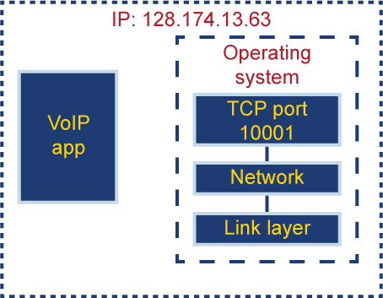
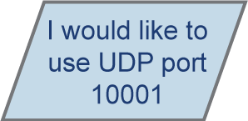
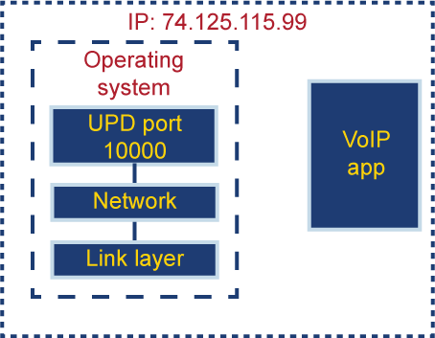
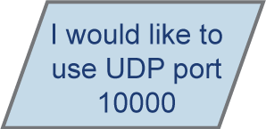
Starting UDP Connection – A High Level View
Server set-up
The server application opens a UDP socket for listening on port 10000.
The operating system returns a socket that can be used for sending and receiving UDP messages.
Client set-up
The client application opens a UDP socket for listening on port 10001.
The operating system returns a socket that can be used for sending and receiving UDP messages.
Socket
UDP
Socket
Internet

Slide 12
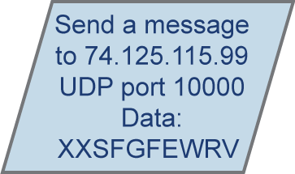

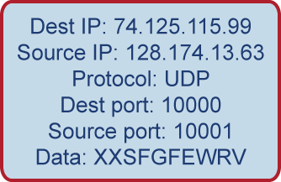
Communicating with UDP
Server set-up
Communicating with UDP
The server application opens a UDP socket for listening on port 10000.
The client application calls a function to send a message to the server.
The operating system returns a socket that can be used for sending and receiving UDP messages.
sendto(socket, …)
Client set-up
The network stack makes the message and sends it into the Internet.
The message arrives at the server.
The client application opens a UDP socket for listening on port 10001.
The server application can retrieve the message from the operating system.
The operating system returns a socket that can be used for sending and receiving UDP messages.
recfrom(socket,…)
Messages can be sent in both directions.
Socket
Socket
Internet

Slide 13
Using TCP vs. Using UDP
TCP requires a connection to be set up before any data is sent.
UDP requires no connection set-up before data
is exchanged.
Before any data is sent, the network stacks in the client machine and
the server machine exchange messages.
The operating system returns a socket that can be used for sending and receiving TCP messages.
Implications
When the message is sent, there is no prior indication
that the server is ready to receive the message.
Implications
When the message is sent, one can be reasonably hopeful that
the message will arrive at the destination.
UDP is faster to set-up.
Sockets
TCP takes longer to set-up.
Each socket is for a port. Data can be sent to and received from any other machine.
Sockets
Besides the listening sockets, each socket is for a single connection
between a client and server.
Socket
Socket
Internet

